Slide 1
Sustainability & Carbon Management
Jo Hossell
Departmental Energy Manager

Slide 2


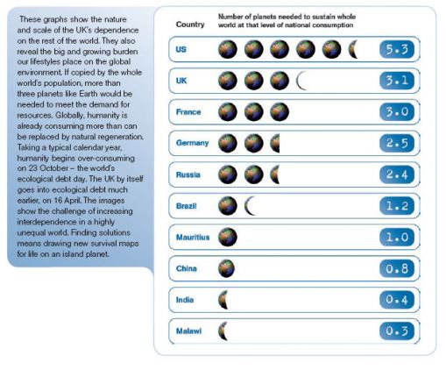
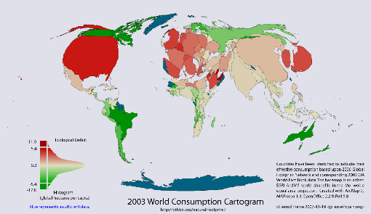


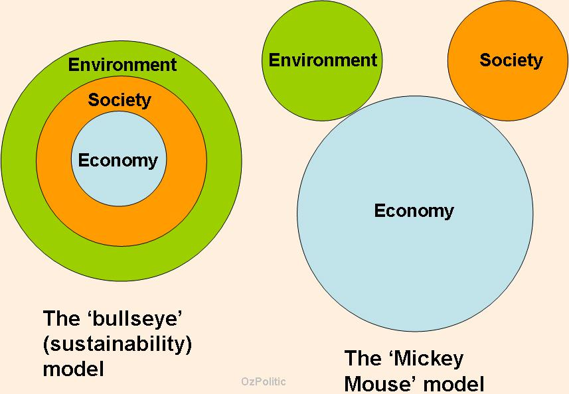


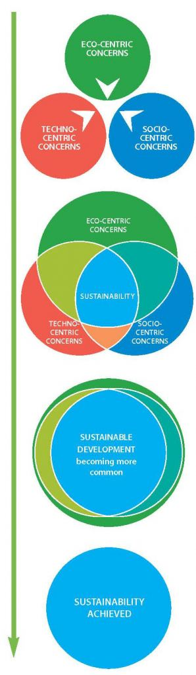


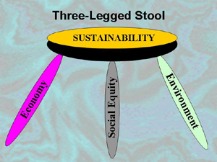




Sustainability

Slide 3
The Drivers of Sustainability
CO₂ management plan - HEFCE funding requires 43% reduction in CO2 by 2020
Carbon Reduction Commitment
DECs – Display Energy Certificates
Energy prices
Planning Permission (10% Renewable/savings)
Recycling incentives
Sustainability credentials for students/researchers

Slide 4
University Energy Usage 2012/13
Gas usage: 95 Million kWh
    Equivalent to ~6,400 homes
Electricity usage: 34 Million kWh
    Equivalent to ~8,200 homes
Carbon emissions: 24,714 tonnes CO2
    Equivalent to 2,250 individuals
Notes:
University only figures – no recharge – Equivalents use 3,300/house electricity 16,500 gas and 15 tonnes UK individual
2011-12 gas
Elec 28,197,951
Gas 60,206,250
CO2 25,147
2010/11
Elec 26,889,037
Gas 64,715,578
Co2 25051

Slide 5


Embedding Sustainability
Part of the University Plan
  Objectives
  Strategy
  Sustainability Action Plan

Slide 6
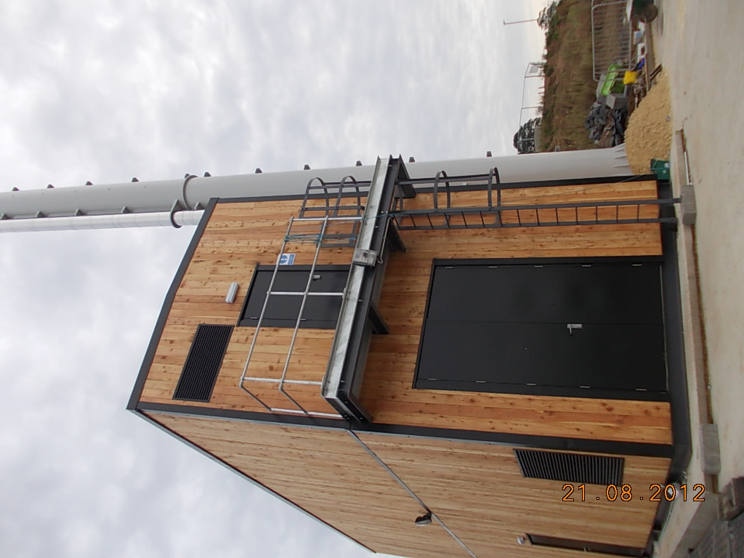

Sustainable Operation
Two new gas 1.5 MWCHPs
Combined Heat and Power production
Saves 6000 tonnes CO2 per year
Equivalent to 920 students, 44 music festivals or 6 return flights between London and New York!
  800kW Biomass Boiler
  Locally sourced & processed woodchip
  CO2 savings 1374tonnes/year

Slide 7

Benefits of onsite generation
New CHPs produce 50% of electricity
Additional heat provided to district heating
Extension of district heating & removal of local hot water tanks
Potential to use excess heat to provide cooling!
Reviewing other sources of on-site renewables

Slide 8
Carbon emissions per student & staff FTE and m²
36% reduction
17% reduction
34% reduction

Slide 9

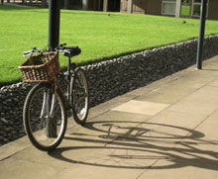
Environmental Footprint
LED street lighting
Sustainable, local & seasonal food
Encouraging cycling, walking & bus travel
Fairtrade Campus
Green Flag Award
National Awards for Travel & Parking & Waste Management

Slide 10
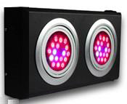
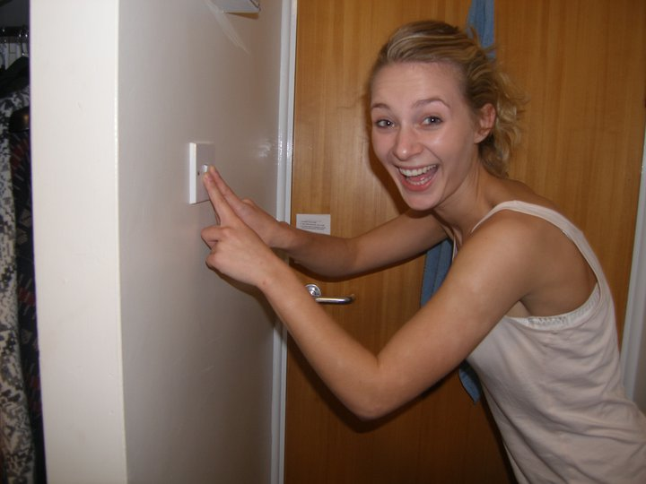
Energy Saving Measures
LED House lights in Jack Lyons (32tCO₂)
LED trial in Biology Glasshouses (5tCO₂)
Draught proofing (157tCO₂)
Server replacement (10tCO₂)
Student & Staff campaigns (106tCO₂) in 2013

Slide 11


Importance of small steps
Energy Use for 24/7 running:
  5 W = £4.50/year (£22,000) e.g. Notebook power supply
  15W = £14/year (£70,000) e.g. set top box (off)
  25 W = £22.00/Year e.g. microwave oven light
  1kW = £900/year e.g. heater

Slide 12
SALIX funding options
Network PC power Management
Free Cooling/Evaporative Cooling
Energy Efficient File Storage Replacement
LED monitors
Server replacement

Slide 13
SALIX requirements
Present energy usage (kWh) – measured if possible – power monitors available
Hours of use
Future energy usage (kWh)
Hours of use
Cost of new technology

Slide 14

How you can help?
Ideas for new technology
Tell us when you are saving energy:
  Significant new purchases
  Centralising departmental servers
    Reducing server numbers
    Changing requirement for room cooling
  Installing power management
  Encouraging users to make use of energy saving technology (YPP, IT instead of paper, VDS etc)

Slide 15
Contact Details
Jo.Hossell@York.ac.uk
Tel: 4126

