Slide 1
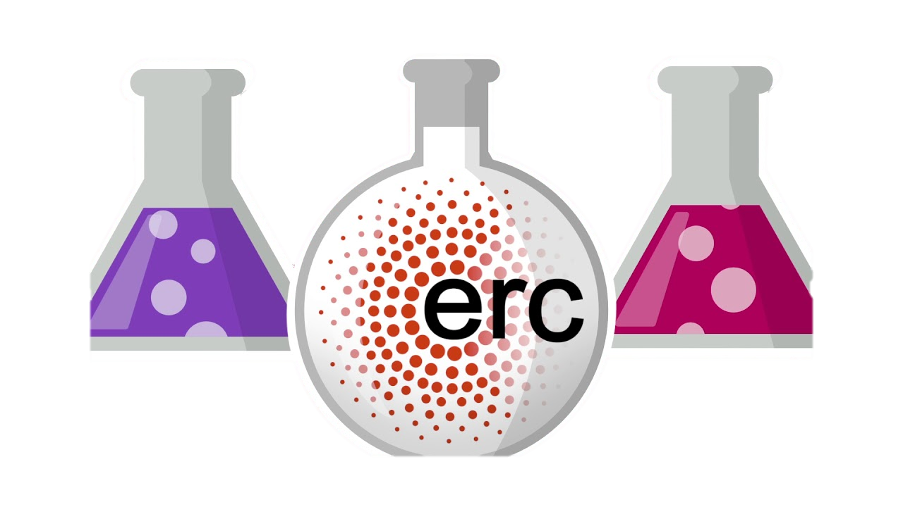
Parent-mediated play‐based interventions to improve social communication and language skills of preschool autistic children: A systematic review and meta-analysis protocol
Emre Deniz, Gill Francis, Carole Torgerson, & Umar Toseeb
Child and Adolescent Neurodevelopmental Diversity Research Lab (CANDY)
Psychology in Education Research Centre (PERC)
Notes:
Hello, I am Emre Deniz. I am a final year PhD student in the Psychology in Education Research Centre, at the University of York. I am also a member of Child and Adolescent Neurodevelopmental Diversity Research group supervised by Dr Umar Toseeb. In CANDY Lab, our main research interest lay around, play skills, sibling relationships, mental health, and wellbeing in autistic children and adolescents. Today, I am going to present one of our latest studies in which we tested the indirect effects of sibling bullying on the mental health and wellbeing of autistic adolescents. To the best of our knowledge, this is the first study in reporting the mediator role of self-esteem in this association.

Slide 2
Play & Autism
Autism is a pervasive neurodevelopmental condition with a prevalence of approximately 1 in 44 children in the US [28].
Autism is characterised by persistent deficits in social communication, and language skills [29].
Autistic individuals may exhibit some or all of the following: deficits in social-emotional reciprocity, reduced sharing of interests, failure to initiate or respond to social interactions, deficits in nonverbal (e.g., eye contact, gestures, and facial expressions), and verbal communication.
Early years interventions have shown to be effective in improving the social communication and language skills of autistic children.
Therefore, various play-based interventions have been developed to support those developmental areas of autistic children.
Although researchers have previously reported the overall effectiveness of different types of play-based interventions on the social communication and language skills of autistic children, no previous systematic reviews have yet evaluated the effectiveness of parent-mediated play-based interventions in preschool autistic children.

Slide 3
Direct play therapy
Therapist & child

Slide 4
Indirect play therapy: Therapist & Parents/Peers/Teachers & Child

Slide 5
The Current Study Protocol
In the current protocol, the following elements of the proposed systematic review and meta-analysis are reported:
Aims,
Research questions,
Study methodology (e.g., target sample, search strategy, inclusion criteria, predictor and outcome variables, data extraction, quality appraisal, and data analysis),
Conflict of interest.
Notes:
Although the literature suggests a link between sibling bullying and self-esteem, sibling bullying and mental health, and self-esteem and mental health, the evidence on the longitudinal associations between sibling bullying, self-esteem, and mental health and wellbeing in autistic adolescents is limited. The current study, therefore, aims
to investigate whether sibling bullying in early adolescence is associated with positive and negative mental health in late adolescence.
to investigate the relationship between sibling bullying in early adolescence and self-esteem mid-adolescence.
to investigate the relationship between self-esteem in mid-adolescence and positive and negative mental health in late adolescence.
Lastly, to investigate whether the associations between sibling bullying in early adolescence and mental health and wellbeing in late adolescence are mediated by self-esteem in mid-adolescence.

Slide 6
The Current Study Protocol
The overarching aims of the main study will be to;
report the key characteristics and
synthesise the results of the included studies
To address these aims, the following research questions will be asked:
What are the key characteristics of parent-mediated play-based interventions?
How effective are parent-mediated play-based interventions in improving the social communication and language skills of preschool autistic children?
What factors, if any, mediate/moderate the impact of parent-mediated play-based interventions on children’s social communication and language outcomes?
Notes:
Although the literature suggests a link between sibling bullying and self-esteem, sibling bullying and mental health, and self-esteem and mental health, the evidence on the longitudinal associations between sibling bullying, self-esteem, and mental health and wellbeing in autistic adolescents is limited. The current study, therefore, aims
to investigate whether sibling bullying in early adolescence is associated with positive and negative mental health in late adolescence.
to investigate the relationship between sibling bullying in early adolescence and self-esteem mid-adolescence.
to investigate the relationship between self-esteem in mid-adolescence and positive and negative mental health in late adolescence.
Lastly, to investigate whether the associations between sibling bullying in early adolescence and mental health and wellbeing in late adolescence are mediated by self-esteem in mid-adolescence.

Slide 7
Methods
Study Design: A systematic review and meta-analysis
Target Sample: Preschool autistic children
Predictor variables: Parent-mediated play-based
interventions
Outcome variables: Autistic traits, social communication, and language outcomes.
Data Extraction: Information related to intervention types, play approaches, sample sizes, experimental designs, etc.
Quantified outcomes: Numbers, means, standard deviations, standard errors, confidence intervals, and reported effect sizes (Standardised mean differences).
Notes:
This is a longitudinal study in which data comes from the UK Millennium Cohort Study. So, we drew a sample of 416 autistic adolescents aged 11 to 17 who had at least one sibling at ages 11 and 14. Since this was a secondary data analysis, we had a lot of missing data to handle. For doing this, we used two advanced statistical techniques: Multiple imputation by chained equations for Descriptive statistics & Maximum Likelihood with Missing Values for inferential statistics. We had four very well validated and standardised scales: These were Sibling Bullying Questionnaire, Rosenberg Self-Esteem Scale, Strength and Difficulties Questionnaire, and Warwick-Edinburgh Mental Wellbeing Scale.

Slide 8
How did we follow the open science practice?

Slide 9
Pre-registration
1st step:
We pre-registered our
study protocol with PROSPERO
(The International Prospective
Register of Systematic Reviews)

Slide 10
Prisma Statement & Checklist
2nd step:
We followed the PRISMA
statement and PRISMA-P
checklist (Preferred Reporting
Items for Systematic review and
Meta-Analysis Protocols) when
pre-registering our study
protocol with PROSPERO.
Notes:
In terms of the demographic characteristics of the sample, The mean age was 11.16 years at the first wave.

Slide 11
OSF Public Project
3rd step:
We created an OSF project for
our study protocol and uploaded
all supplementary materials and
figures into our OSF project. All
supplementary documents were
made publicly available for other
researchers aiming reproducibility
and replicability.

Slide 12
Preprint: PsyArXiv
4th step:
We submitted our study protocol
to PsyArXiv as a Preprint which is a
preprint repository for the
psychological sciences hosted by the
Center for Open Science (OSF). Our
pre-print is linked to our OSF project
and our registered study protocol so all
supplementary files can be read easily.

Slide 13
Open Access Publication
5th step:
We submitted our study protocol
to PLOS ONE, which is a non-profit
Open Access Journal. PLOS ONE is in
publishing agreement with the
UoY, that is, all researchers can
freely publish their research on PLOS
ONE with no extra publication fee.
Our protocol has recently been accepted for open access publication and is now in production (PLOS ONE).

Slide 14
CANDY LAB: Latest Open Access Publications - 2022
Parent-mediated play‐based interventions to improve social communication and language skills of preschool autistic children:
A systematic review and meta-analysis protocol E Deniz, GA Francis, C Torgerson, U Toseeb
Play-based interventions for mental health: A systematic review and meta-analysis focused on children and adolescents with autism
spectrum disorder and developmental language disorder GA Francis, E Deniz, C Torgerson, U Toseeb
A Longitudinal Study of Sibling Bullying and Mental Health in Autistic Adolescents: The Role of Self-esteem E Deniz, U Toseeb
Sibling Bullying in Turkish Adolescents: Translation and Cross-Cultural Validation of the Sibling Bullying Questionnaire Deniz et al., 2022
A longitudinal study of the mental health of autistic children and adolescents and their parents during COVID-19: Part 2, qualitative findings K Asbury, U Toseeb
Sibling bullying: a prospective longitudinal study of associations with positive and negative mental health during adolescence U Toseeb, D Wolke
Sibling conflict during COVID‐19 in families with special educational needs and disabilities U Toseeb
How did autistic children, and their parents, experience school transition during the Covid‐19 pandemic? A Code, L Fox, K Asbury, U Toseeb
Educational technology for learners with disabilities in primary school settings in low-and middle-income countries: a systematic literature review P Lynch, N Singal, GA Francis
Parents’ Experiences of the Impact of Changing School During COVID-19 on their Autistic Child’s Friendships: an Interpretative Phenomenological Analysis L Fox, K Asbury, A Code, U Toseeb

Slide 15
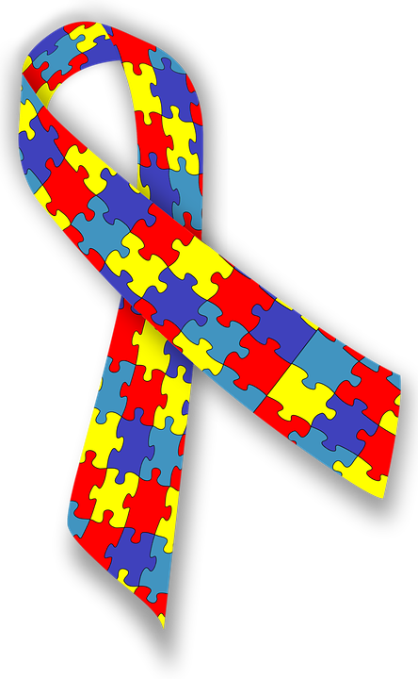
Thanks for listening
References & Resources
Further information regarding the presented study and cited resources can be found on Emre Deniz’s open science framework web profile (OSF) https://psyarxiv.com/a7r9t/
Notes:
“Thank you for your time. I would also like to thank all autistic adolescents and their parents who took part in the Millennium Cohort study. Just a reminder, you can further read our article and all other resources used in this presentation on my OSF profile. I’ll now hand over to the chair of this session who will introduce the next presenter. If you have any questions, please save them to the Q&Q session where I will be gladly answering them.

