Slide 1
The FAIR Data Checklist – A Case from the School of English
Yi Liu
2022/9/12

Slide 2
Overview
Background
The FAIR Checklist
At the start of your research
During the research process
At the end of your research

Slide 3
Background
What do we know about FAIR?
A quick pre-event survey
19 PGR students and 3 Established researchers
Linguistics and Literature

Slide 4
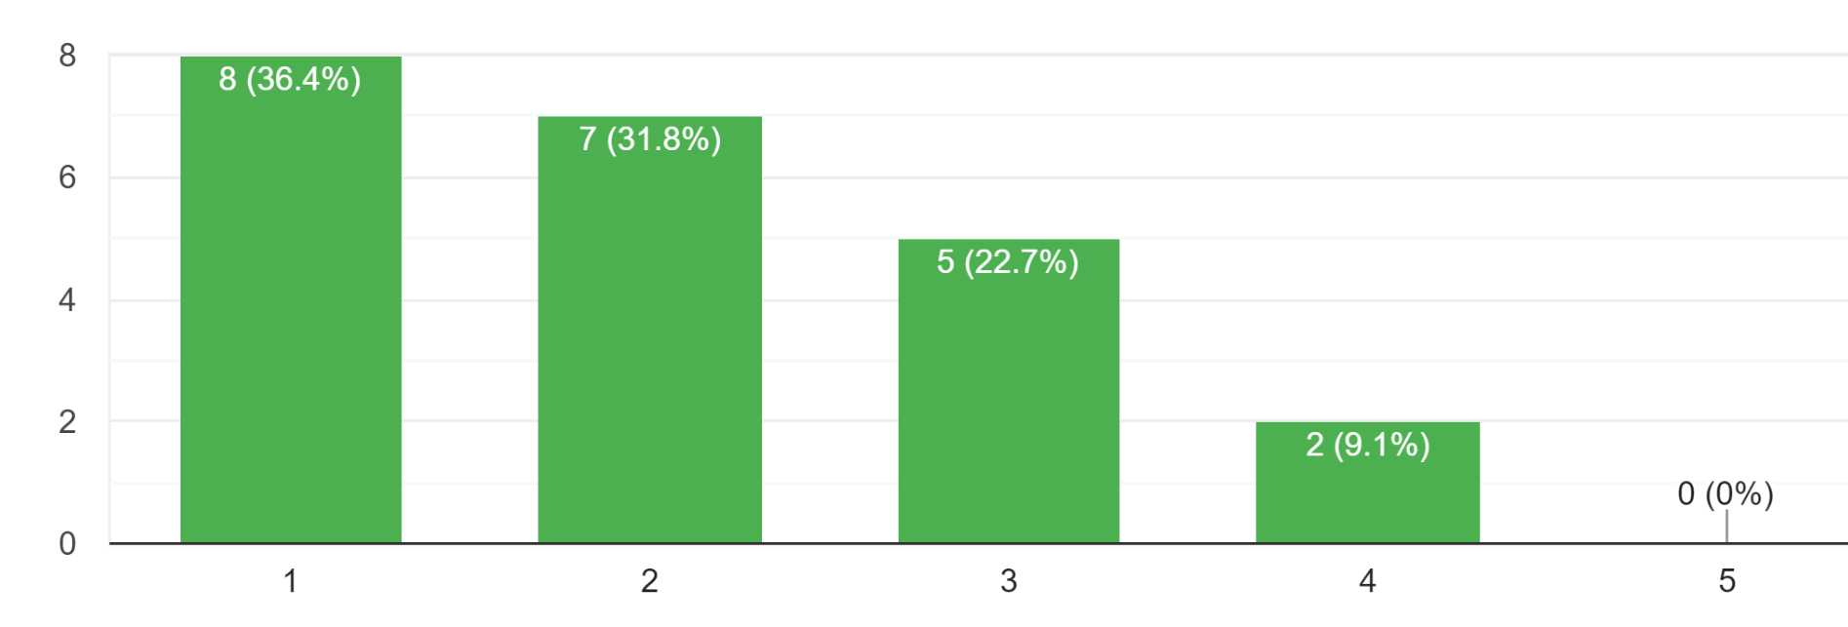
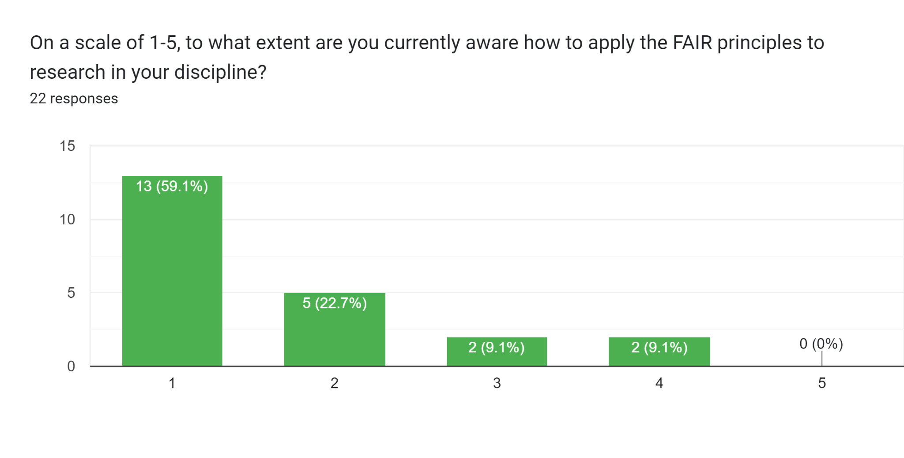
Background
Figure 1 Awareness of the FAIR principles (on a scale of 1-5)
Figure 2 Awareness of how to apply the FAIR principles (on a scale of 1-5)

Slide 5
Background
What is research data?
‘The evidence used to inform or support
research conclusions’
Spreadsheets, archived materials, images,
videos, audio, code and software…
Digital or non-digital
(Source: https://www.sheffield.ac.uk/library/rdm/whatisrdm)
Notes:
It doesn’t matter if your subject is linguistics or literature.

Slide 6
Background
What is FAIR?
Findable:
easy to find for both humans and computers
Accessible:
easy to be accessed
Interoperable:
can be integrated with other data and interoperate with applications or workflows
Reusable:
can be replicated and/or combined with other data in different settings

Slide 7
Background
Why is it important?
FAIR Data enables the research community to:
Maximise the value and usefulness
Increase the accountability of research and the verifiability of results
Enhance the potential for collaboration
Speed up the progress of academic research

Slide 8
The FAIR principles not only
apply to STEM (Science, technology, engineering, and mathematics),
but they are also highly relevant to
the Arts and Humanities.

Slide 9
Plan (at the start of your research)
Think about what data you are going to use or collect, and what can be shared at the end of your research:
Can it be reused for future research by yourself? Can it be reused for other research aims by other researchers?
Can your experiment design, workflow, or code and software be reused by others?
If your research involves human participants, how much consent is required, and for how long should you obtain for the storage and sharing of data?
If your research involves materials archived by yourself or your research team, can they be published for future reference and be reused by others?
Notes:
As this checklist

Slide 10
Plan (at the start of your research)
Make a data management plan (DMP):
Use DMFonline to create your plan: https://dmponline.sheffield.ac.uk
Notes:
For researchers

Slide 11
Collect, Organise, Deposit (during the research process)
Finding and reusing existing data
Use data archives, repositories, and databases
Keep a record of data and where it was found
Check terms and conditions:
Are the data publicly available and will they continue to be?
Are there restrictions on sharing the data and data derived from them?
Do arrangements have to be made with the original researcher(s)?
Don’t assume you can share/use data just because they are available online

Slide 12
Collect, Organise, Deposit (during the research process)
Documenting and Organising
Make data clear to understand and easy to use. Check out and use the existing data formats and standards in your research area.
clear file naming and folder structure
Comprehensive data documentation and metadata

Slide 13
Collect, Organise, Deposit (during the research process)
Storing and archiving
Store your digital data securely
Backups: 3-2-1 (3 copies, 2 different media, 1 off-site)
If you collect or create physical data, digitise them if possible.

Slide 14
Collect, Organise, Deposit (during the research process)
What else can or should be archived?
You may also need to make your own archives as online data may disappear or the existing digitalisations are of low quality (e.g., pixelated, missing pages, no metadata).
Things to consider when archiving data:
Any legal or ethical obligations to delete or retain specific data
How long data needs to be archived (usually minimum 10 years)
Possible financial implications of long-term storage

Slide 15
Share (at the end of your research)
Benefits of sharing:
Greater impact and visibility of research
Credit for research outputs
Potential for increased citation rates
New collaborations between data users and data creators
Knowledge Exchange
……
Notes:
Shari

Slide 16
Share (at the end of your research)
What to share?
Share data that validates your research, especially if it has potential for reuse.
Check if you have permission to share the data.
Observe all terms of participant consent regarding data sharing.
Consider what to do with sensitive data

Slide 17
Share (at the end of your research)
Prepare your data to share
Transfer your data to an open or more widely accessible format.
Use the existing data formats and standards in your research area
Place a data availability statement, including a DOI.
Select an appropriate licence or conditions for the reuse of your data and software

Slide 18
Share (at the end of your research)
Where and how to share
Share data openly through archives, repositories, and databases (see the resources in the checklist).
Make any delay to the release of data as short as possible and within funder requirements.
Make access arrangements for physical data if they are important for validation or reproduction of your research and cannot be digitised.

Slide 19
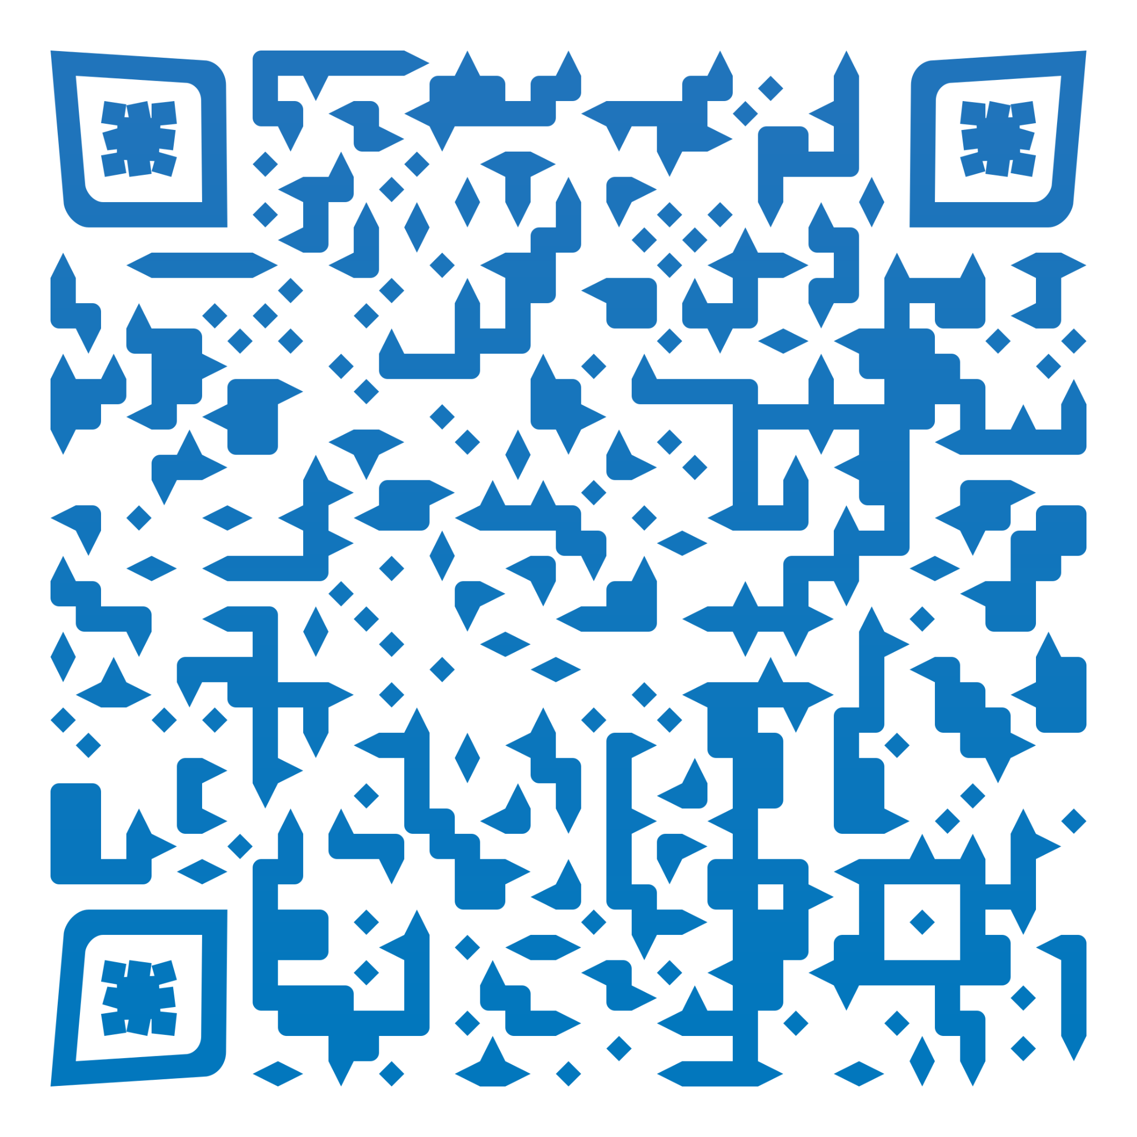
Thanks!
Adams, J., Abdalla, T., Zagrodzka, Z., Simsek, D., Liu, Y., Bowman, D., et al. (2022). Departmental FAIR checklists. The University of Sheffield. Workflow.
DOI: https://doi.org/10.15131/shef.data.20496855.v1

