Slide 1
‘Open’ Practice Research (Arts)
Dr Scott McLaughlin
University of Leeds (School of Music)

Slide 2
Overview
Practice research
Reproducibility
Repository (SPARKLE)
Challenges
  IP maximalism
  Ethics (data privacy, re-use)
    Public participants vs professional participants
    Re-use of art and documentation (the unknowable future)

Slide 3
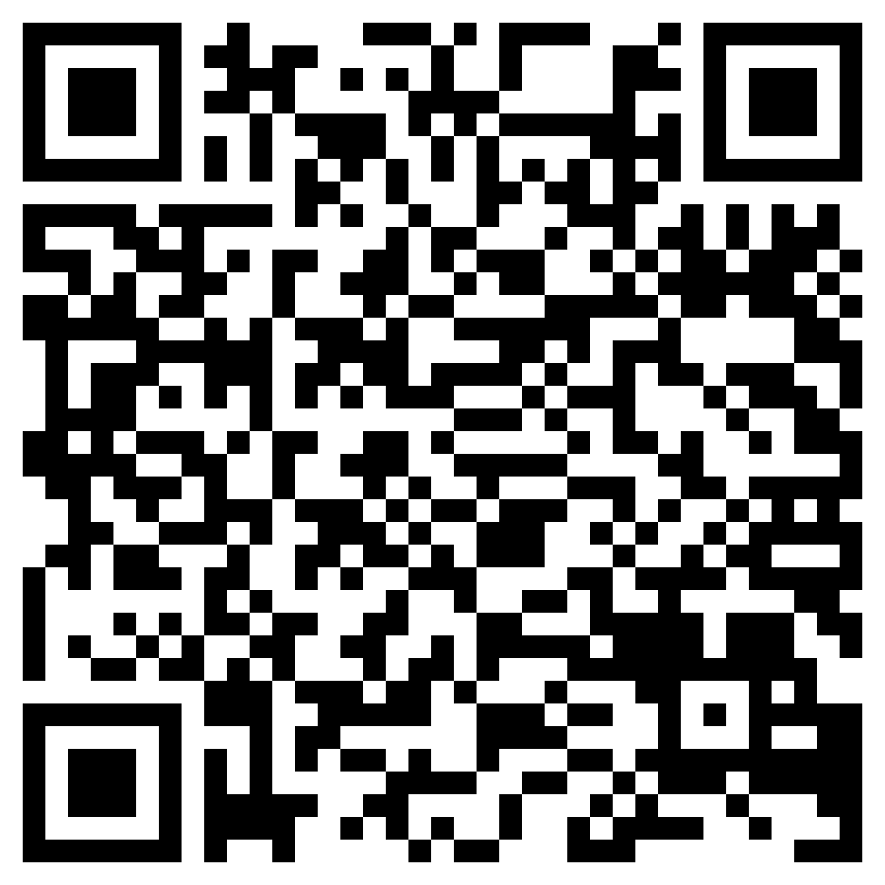


Slide 4
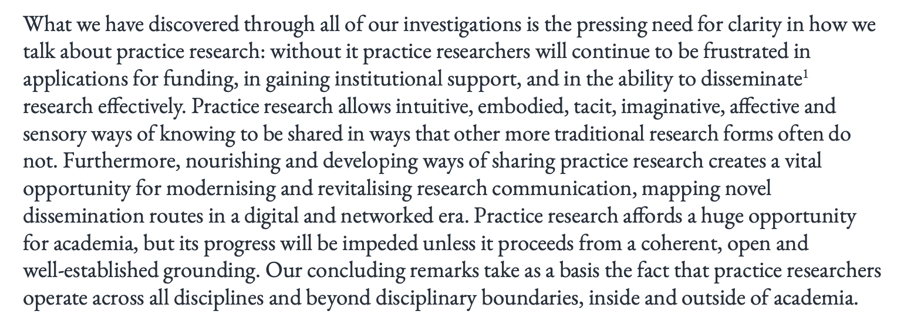

Slide 6
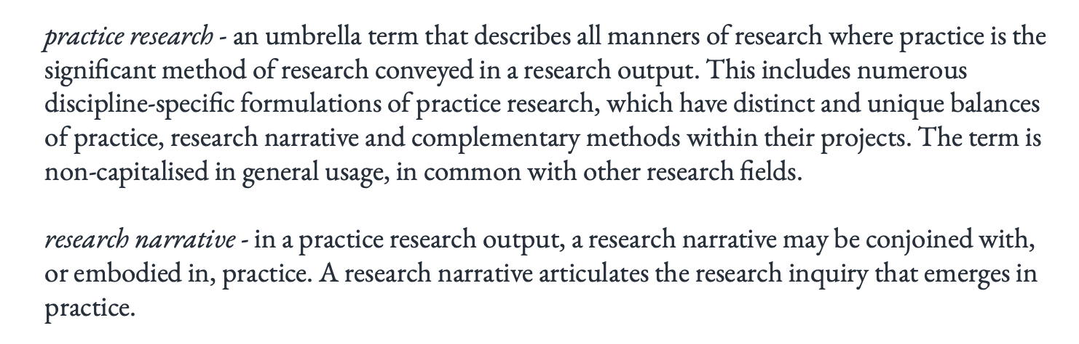

Slide 7

For the purposes of the REF, research is defined as a process of investigation leading to new insights, effectively shared.
Notes:
PR is for life not for REF, but REF criteria are useful agree standard for what we mean by ‘research’

Slide 8

research activities should primarily be concerned with research processes, rather than outputs.
Our primary concern is to ensure that the research we fund addresses clearly-articulated research questions, issues or problems, set in a clear context of other research in that area, and using appropriate research methods and/or approaches.
Notes:
Mapping
AHRC have no ‘effective ‘sharing’

Slide 9
clearly-articulated research questions, issues or problems
a process of investigation
leading to new insights
set in a clear context of other research in that area
effectively shared
?
Notes:
Mapping
AHRC have no ‘effective ‘sharing’

Slide 10
The research should be conceived as broadly as possible and so consideration should also be given to the outcomes of, and audiences for, the research. The outcomes of the research may only benefit other researchers and influence future research, but consideration must be given to potential opportunities for the transfer of knowledge into new contexts where the research could have an impact.
Note the stress is ‘may ONLY benefit’, or ‘[could] only benefit’, meaning you can have projects
aimed solely at researchers (the basic assumption) but also see the blue part.

Slide 11
REF2021 panel feedback to the sector
Practice research submissions were significantly improved in terms of detailing the research dimensions of the submitted outputs. (p. 24)
outputs were supported by a precise [supporting] statement that articulated the research context, methods and methodology, insights and dissemination. Outputs were often further supported by additional contextual information. (p. 24)
strongest practice research outputs were characterised by precision, depth and brevity in presenting the research dimensions of the work (p. 24)

Slide 12
REF2021 panel feedback to the sector
Weaker submissions did not always sufficiently identify or articulate a research dimension in the materials submitted, with limitations in critical depth, rigorous process or research contextualisation. (p. 24)
In weaker submissions, it was unclear what the output comprised of and what elements were to be assessed […] or conflated research and professional practice. (p. 166)

Slide 13
Repository (SPARKLE)

Slide 14
Sustaining Practice Assets for Research,
Knowledge, Learning and Engagement
(SPARKLE)
Principal Investigator – Tom Jackson
Co-Investigators: Claire Knowles, Scott McLaughlin, Rachael Kotarski (British Library)
Post-Doctoral Research Associates (PDRA): Alex De Little, Matthew Warren

Slide 15
Methodology
Semi-structured interviews
User-story analysis
Needs
↓
Solutions
Technical consultation

Slide 16
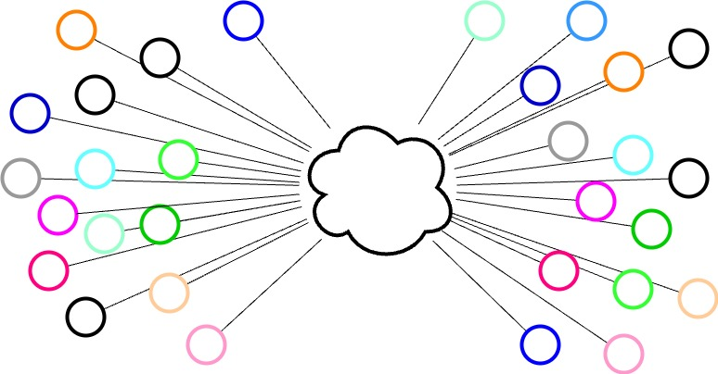
Interviews with stakeholders
Research support
Fine Art
REF Administration
15 practice
researchers*
across…
15 from:
Data
Library
REF
Research
Admin.
Theatre
Non-university Data Repository
Media
Developers/IT
Architecture
Research Data Repository
Digital Humanities
Music
REF Panellists
Librarians
* incl. PGRs and freelancers

Slide 18
Discoverability
Connection
Relationality
Citation

Slide 20
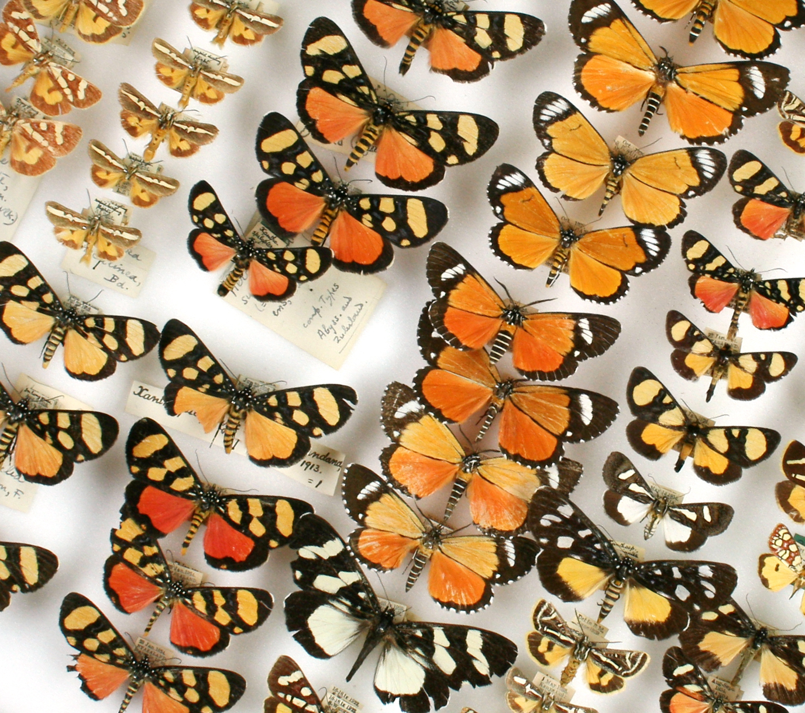
Collections/projects
Notes:
Collections/projects — There is a desire to be able to form groups of entries into collections that represent projects or sets of networked practice research.

Slide 21
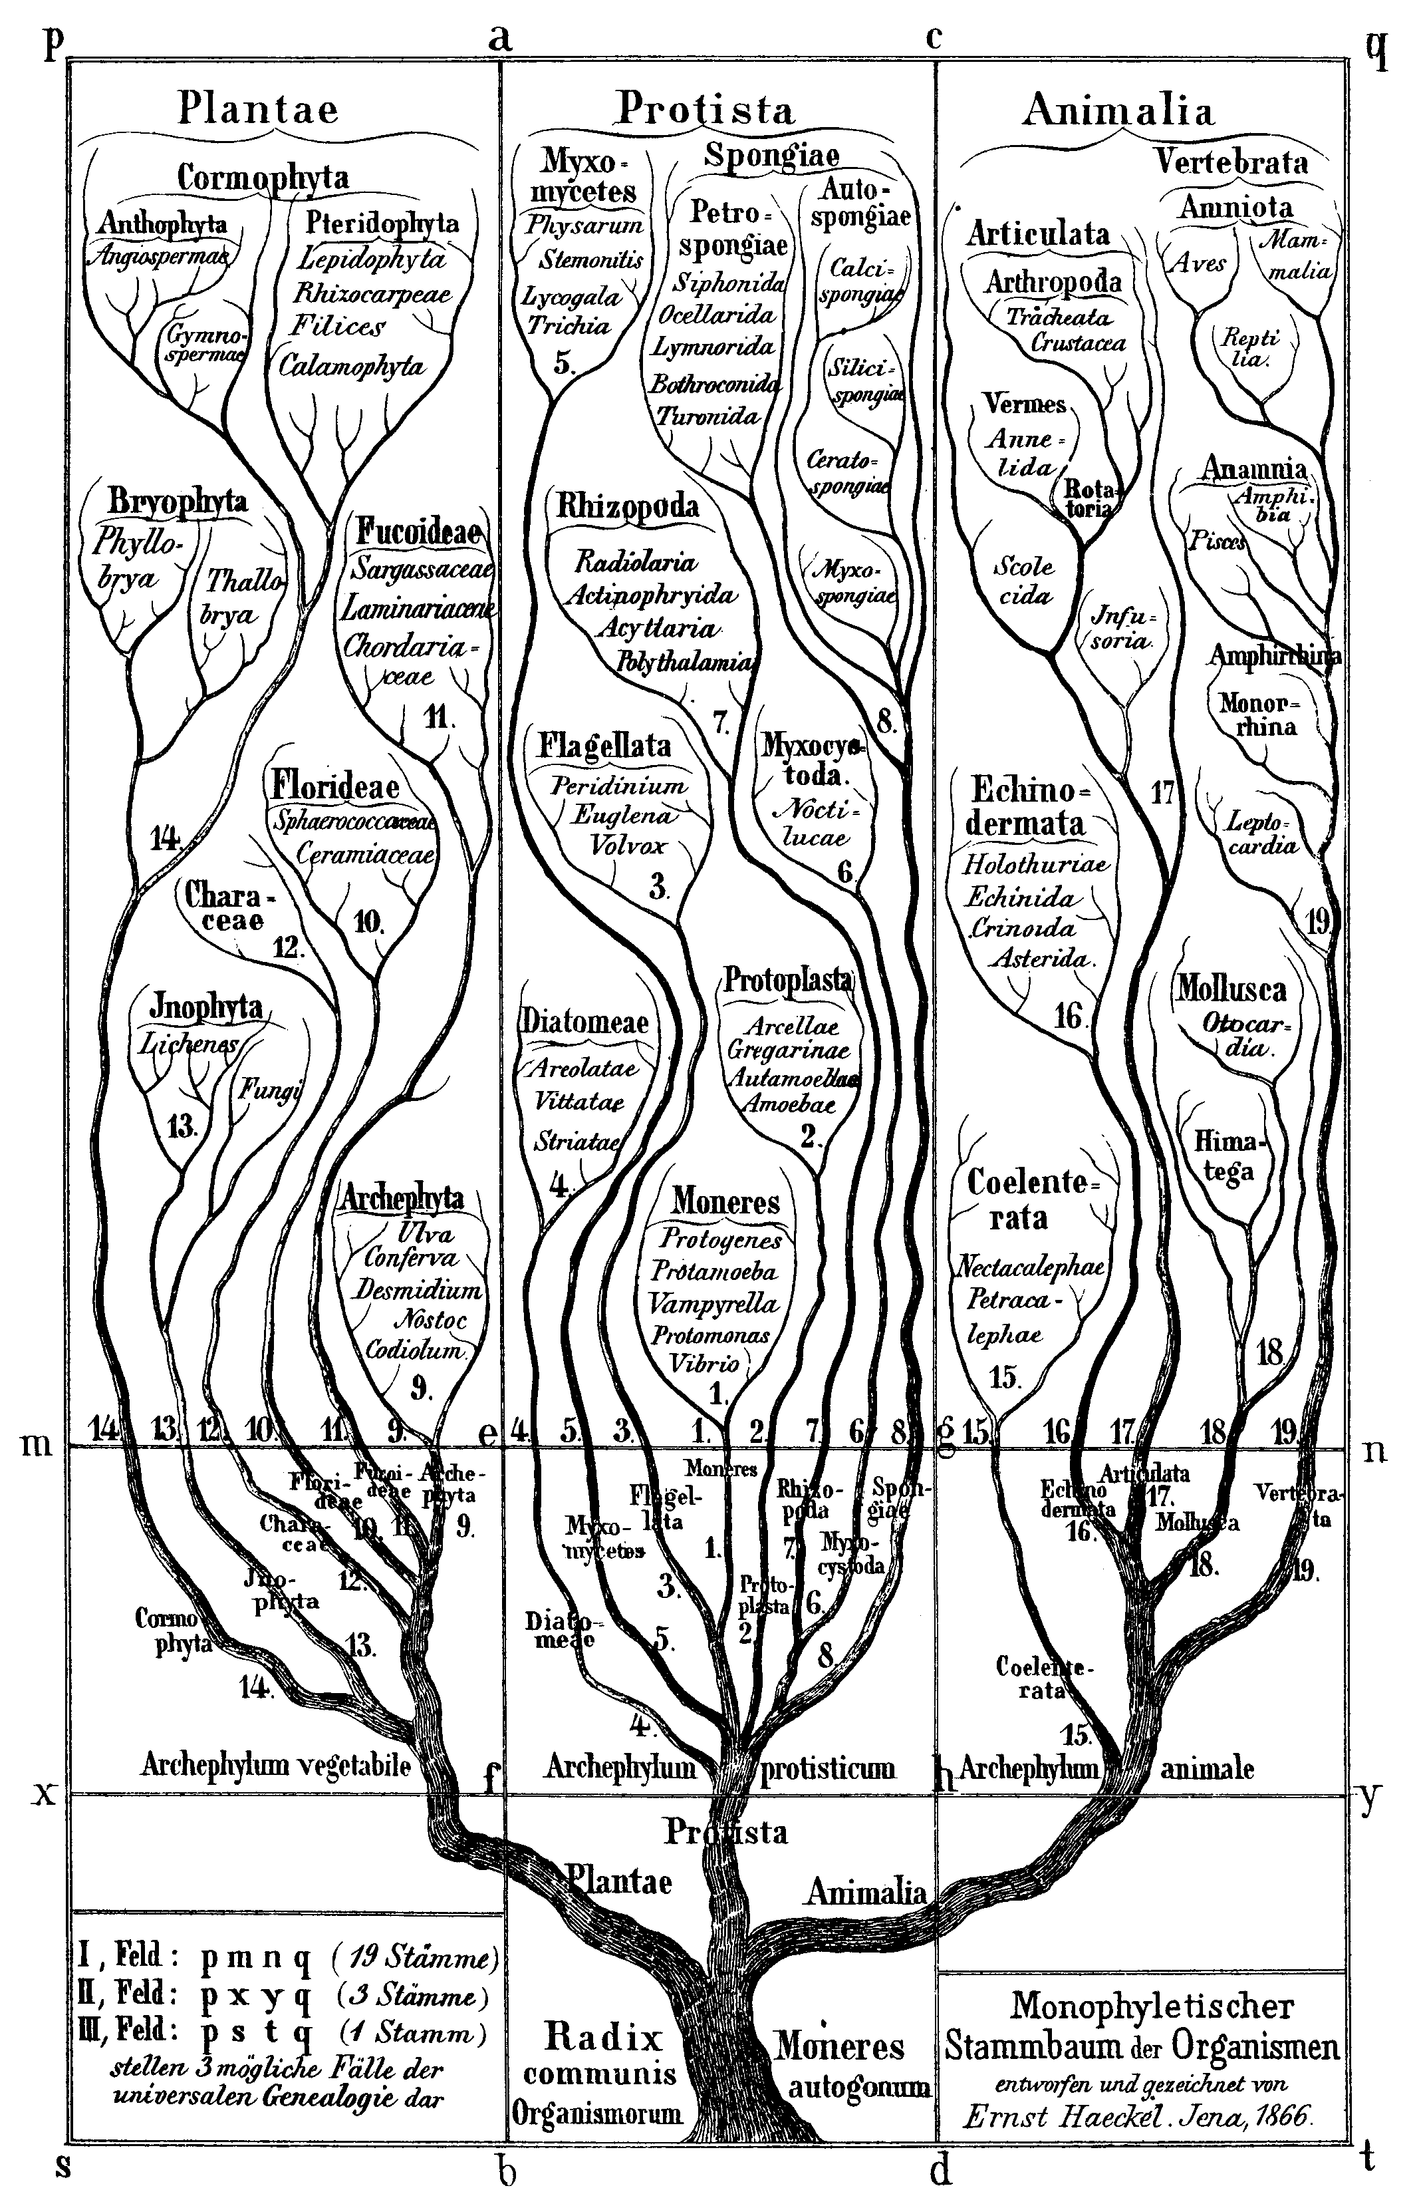
Dating & Histories
Notes:
Dating — Related to the idea of collections is the idea of dating. The ability to reflect the continually developing lives of practice research projects is needed. This also needs to include the ability to see not just the most recent version but also to trace its development. There was the suggestion that accessible archiving of previous versions should be a priority. The ‘Last Modified’ date was also suggested as an important piece of metadata

Slide 22
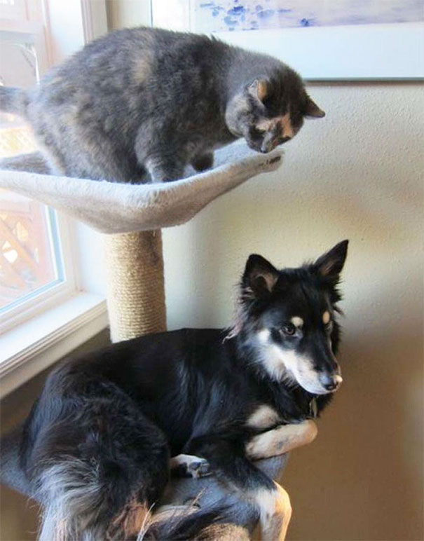
Contexts & translations
Notes:
Documenting Context — It has been highlighted that the context of PR is important but challenging to capture and present, but is also central to understanding it.

Slide 23
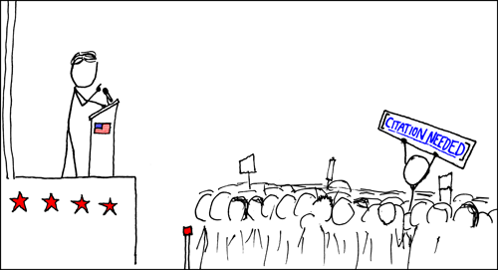
Citations and impact
Notes:
Citations and impact — There is a need to establish a way of recording and quantifying impact where citations are not appropriate (reperformances, adaptations, etc.)

Slide 24
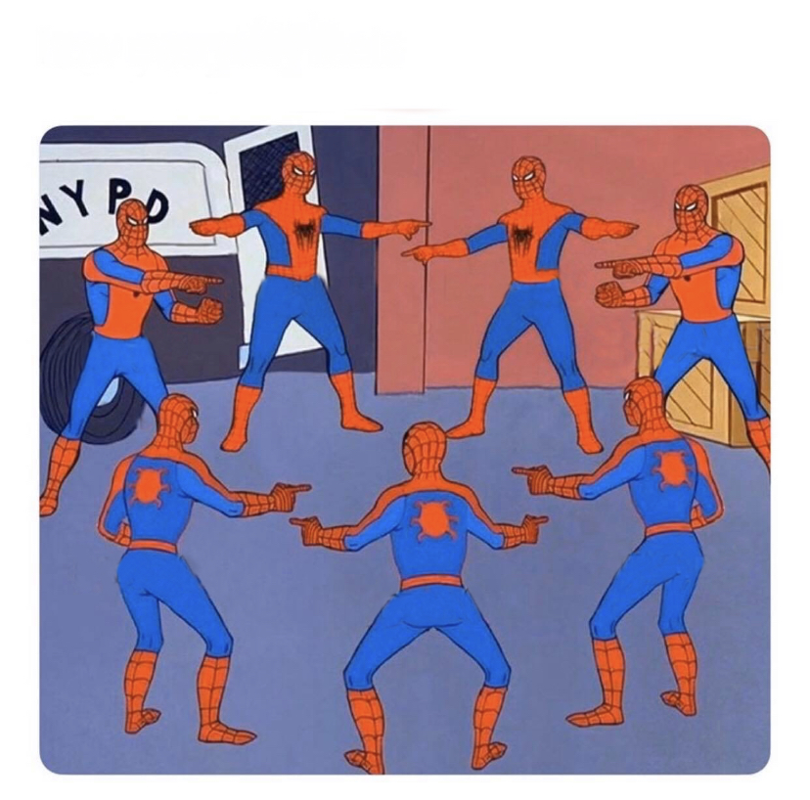
Authors
Creators
Collaborators
Roles
Notes:
Authorship — There is a need for more flexible categories of authorship, acknowledging the diverse and highly collaborative roles at play in much PR.

Slide 25
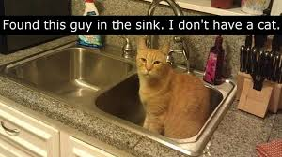
Institutional affiliation
Notes:
— There are views both that clear presentation of institutional affiliation is important to institutional and individual participation and that a perception of a neutral, non-institutionally affiliated space may also be important for other individuals’ participation. In terms of metadata, the key things to bear in mind might be to do with how researchers moving from one institution to another might be recorded in ongoing collections/projects.

Slide 26
For example

Slide 27
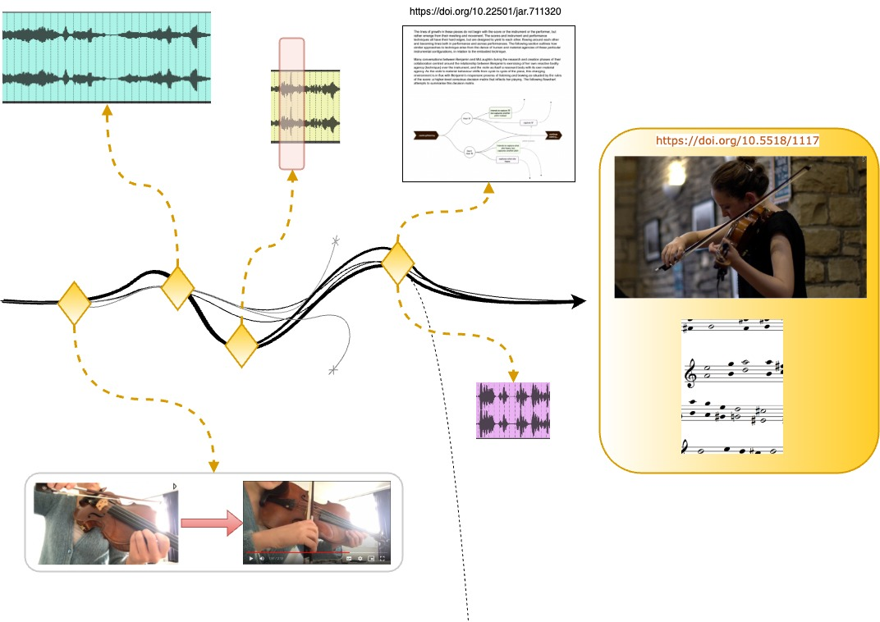


Process
Product

Slide 29
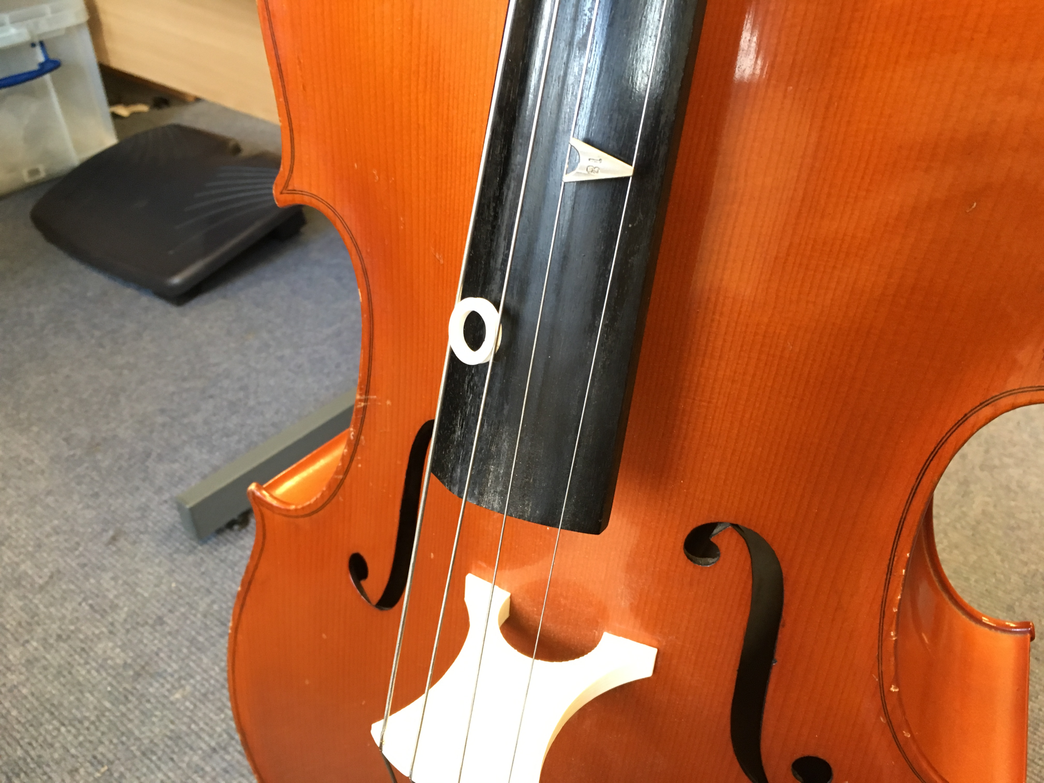
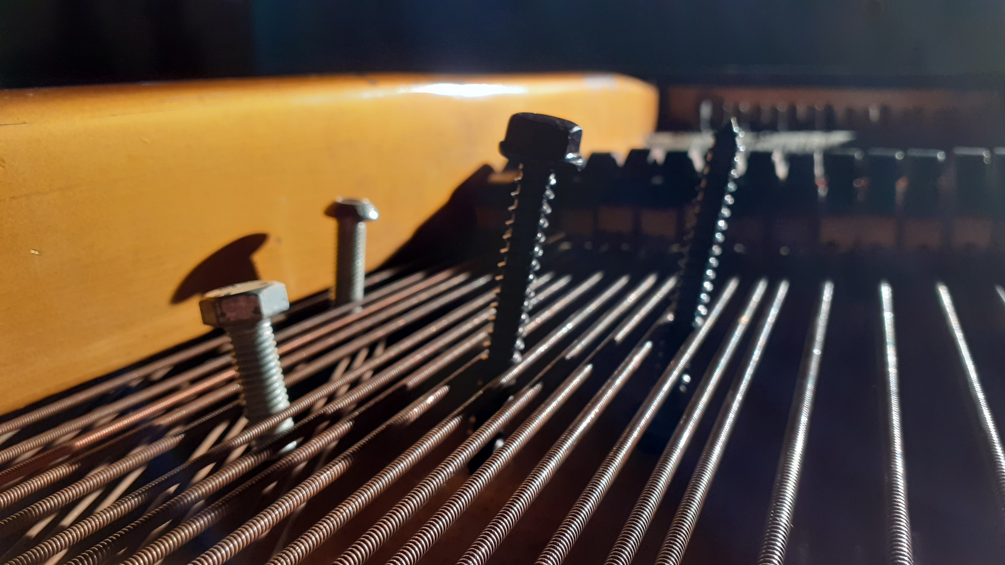

Slide 31
Reproducibility

Slide 32
Challenges
  IP maximalism
  Ethics (data privacy, re-use)
    Public participants vs professional participants
    Re-use of art and documentation (the unknowable future)

Slide 33
summary
Practice research
Reproducibility
Repository (SPARKLE)
Challenges
  IP maximalism
  Ethics (data privacy, re-use)
    Public participants vs professional participants
    Re-use of art and documentation (the unknowable future)

